Slide 1

Sales Forecast
Pushkar Chougule
This Photo by Unknown Author is licensed under CC BY-SA-NC

Slide 2
Content
Business Problem and Background
Data Explanation and Preparation
Feature Exploration and Methods
Machine Learning Models and Evaluation
Conclusion
Assumptions / Limitations / Future Usage
References

Slide 3
Business Problem and Background
Global Superstore Company
Product offerings : Furniture, Office Supplies and Technology
Customer Base : Consumers, Corporates and Home Offices
Generate Insights from Sales data
Sales Forecast to help maintain adequate staffing through year, popular products’ inventories, supply chains for high sales regions / states and make delivery arrangements

Slide 4
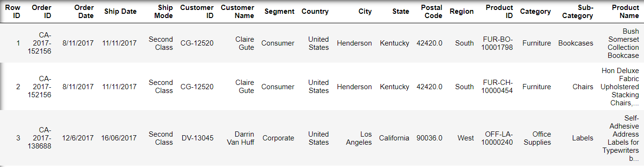

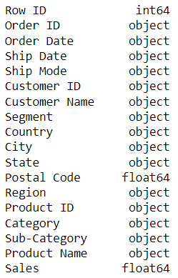
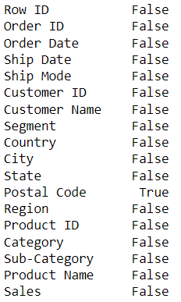
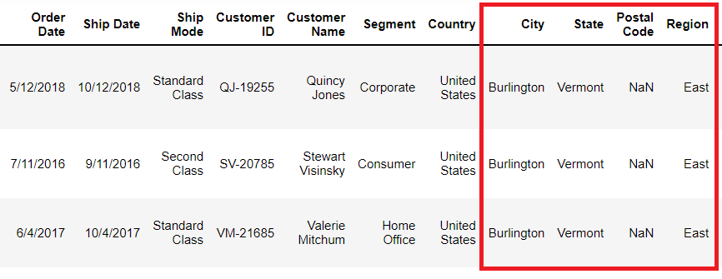
Data Explanation and Preparation
Features with NULL Values
Total of 11 records : For the City of Burlington in the State of Vermont
Replaced with ‘05401’ as default value

Slide 5
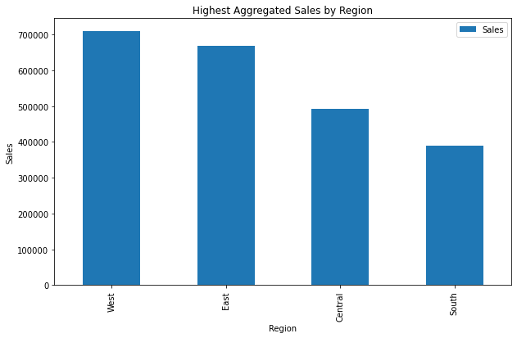
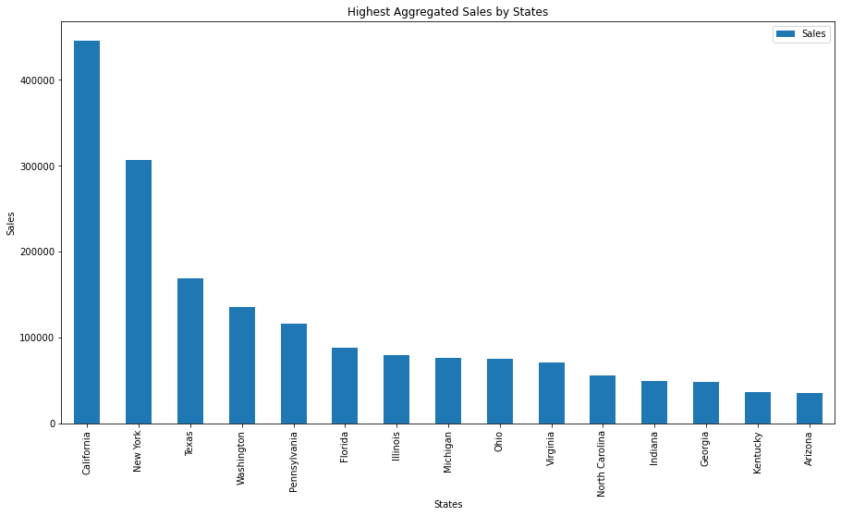
Features Analysis and Methods

Slide 6
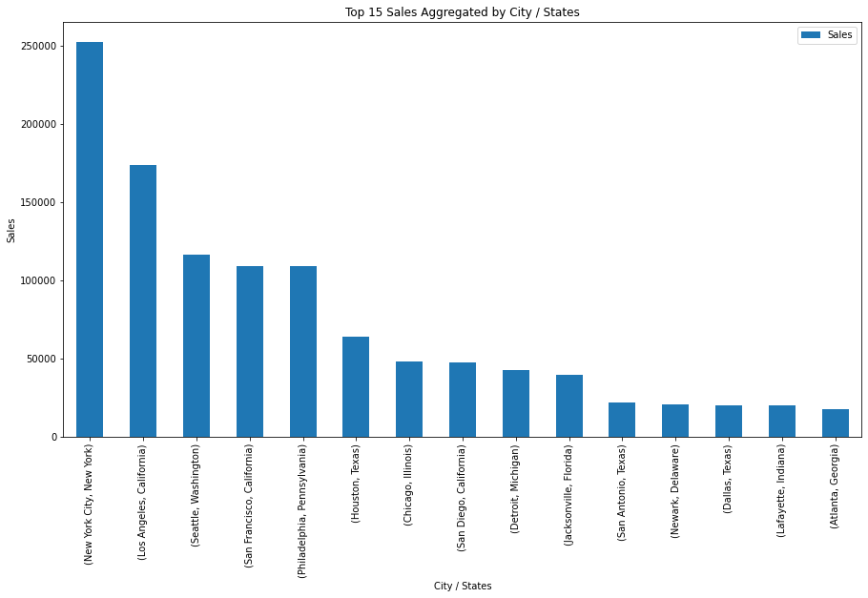
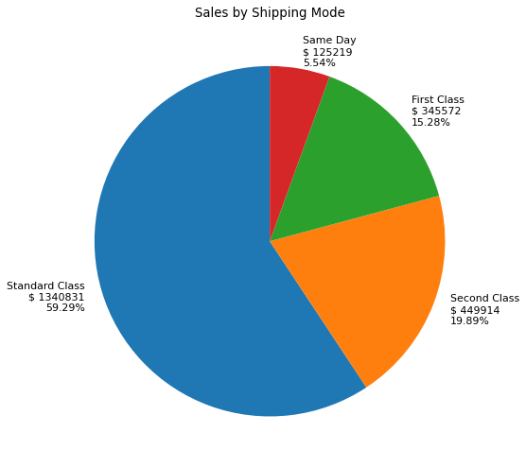
Features Analysis and Methods (continued)

Slide 7
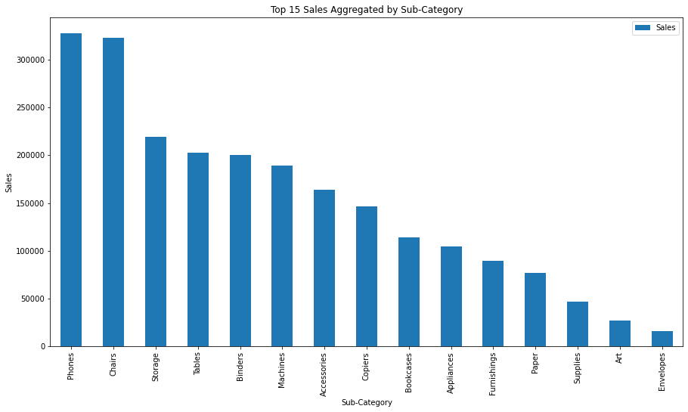
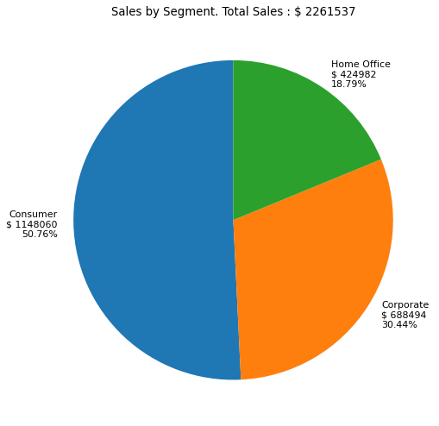
Features Analysis and Methods (continued)

Slide 8
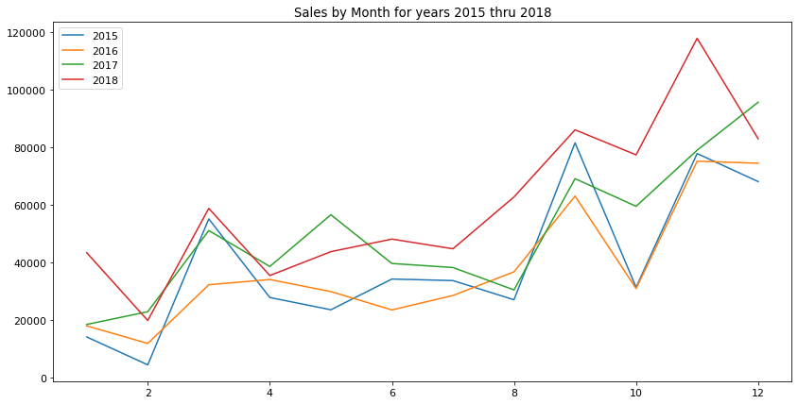
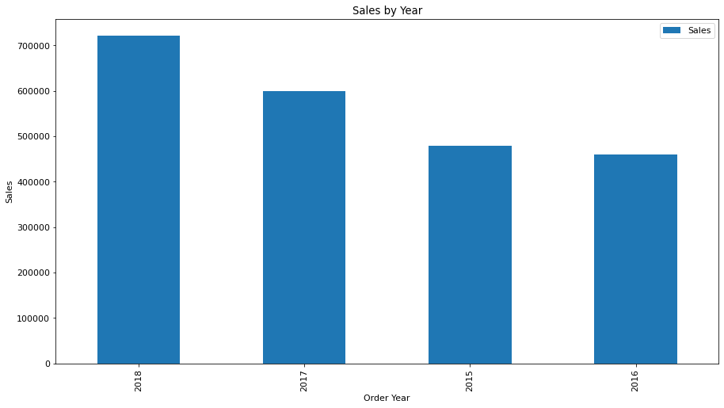
Features Analysis and Methods

Slide 9
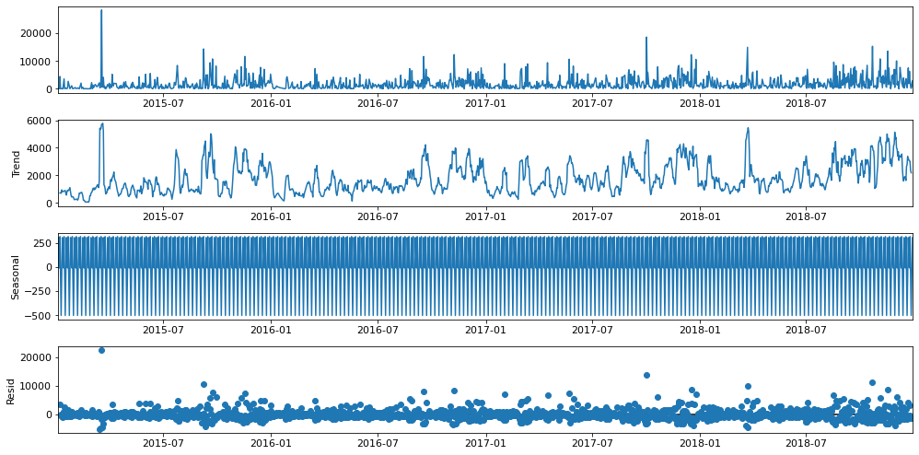
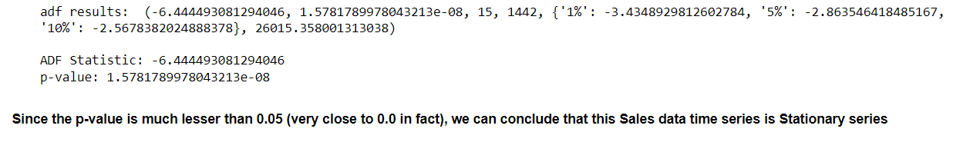
Features Analysis and Methods (Seasonality / Stationary test)

Slide 10

Machine Learning Models and Evaluation
SARIMA
Prophet (fbprophet)
Neural Prophet
LSTM

Slide 11
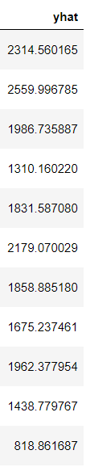
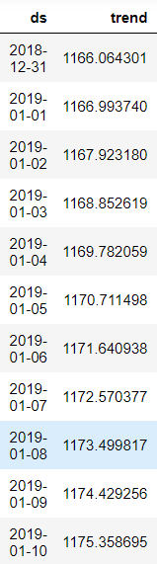
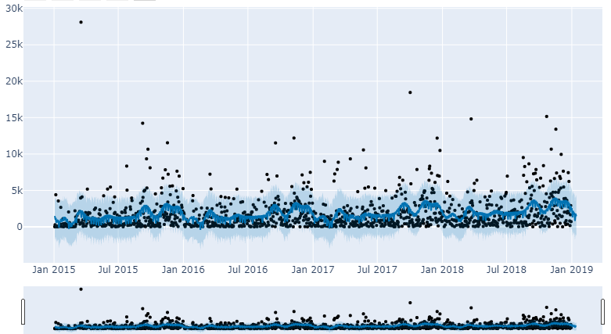
Machine Learning Models and Evaluation (fbprophet)

Slide 12
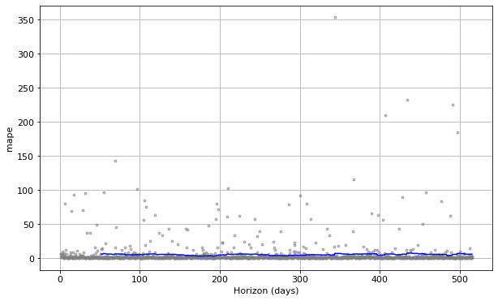
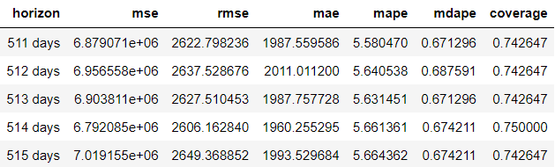
Machine Learning Models and Evaluation (fbprophet)

Slide 13
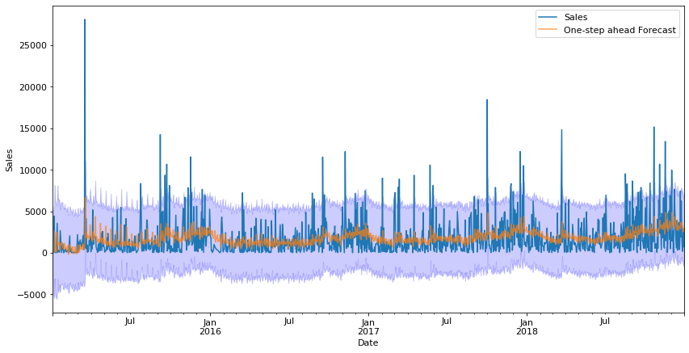
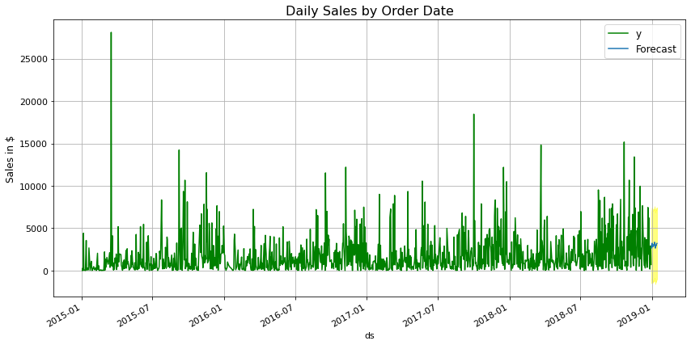
Machine Learning Models and Evaluation (SARIMA model)

Slide 14
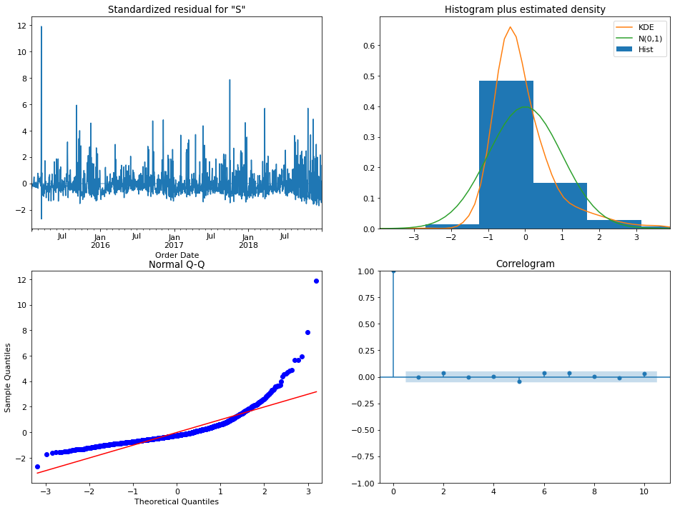
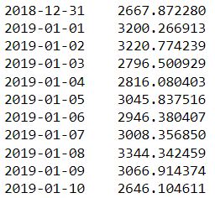
Machine Learning Models and Evaluation (SARIMA model)
The correlogram on the bottom right suggests that there is no autocorrelation in the residuals. Therefore, these residuals are not correlated, and the mean is close to zero.

Slide 15
Conclusion
Looking at the Sales trends, we can see higher level of staff would be needed to support the operations during the Months October to January of following year and in the March
West and East regions contribute to high level of Sales. So, inventories, operations and supply chains need to be fully ready to support the customer demands in these regions / states.
The states of California, Washington, Texas, New York and Pennsylvania would see higher sales. So, maintain the sufficient inventories and staff levels in these places.
Maintain sufficient inventory of the supplies in the Phones, Chairs, Storage Units, Tables as these contribute to higher level of Sales
Customers in Consumer segments have high level of demands, which need to be supported
Standard and Second-class Shipping modes are important for the business and hence shipping arrangements need to be made appropriately
Expected Daily Sales levels would be in the range of $1000 - $2600 in the rolling 10 days time

Slide 16
Assumptions / Challenges / Future Usage
Assumption: The data has no outliers in terms of Sales figures. Most of the other information being text, has no issues.
Challenges / Limitations : Sales data having occasional spikes causes the sales predictions to be wide range bound and may deviate from actuals
Future Usage : The model can be partially utilized, or new system can be developed to forecast at the customer segments, sub-category, states, city level sales

Slide 17
References
Data source : https://www.kaggle.com/rohitsahoo/sales-forecasting
Sharma, Rishabh (2021) “How to build SARIMA model in Python” https://medium.com/mlearning-ai/how-to-build-sarima-model-in-python-7ae83b14c884
Brownlee, Jason (2020) “Timeseries forecasting with Prophet in Python” https://machinelearningmastery.com/time-series-forecasting-with-prophet-in-python/
https://machinelearningmastery.com/time-series-forecasting-methods-in-python-cheat-sheet/
https://facebook.github.io/prophet/docs/diagnostics.html
https://nextjournal.com/fb-prophet/facebook-prophet-diagnostics
Berk, Michael (2021) “Prophet vs. NeuralProphet” https://towardsdatascience.com/prophet-vs-neuralprophet-fc717ab7a9d8
Alizadeh, Esmaeil (2020) “NeuralProphet: A Time-series modeling library based on Neural-Networks” https://towardsdatascience.com/neural-prophet-a-time-series-modeling-library-based-on-neural-networks-dd02dc8d868d

Slide 18

THANK YOU
This Photo by Unknown Author is licensed under CC BY-SA

